Slide 1
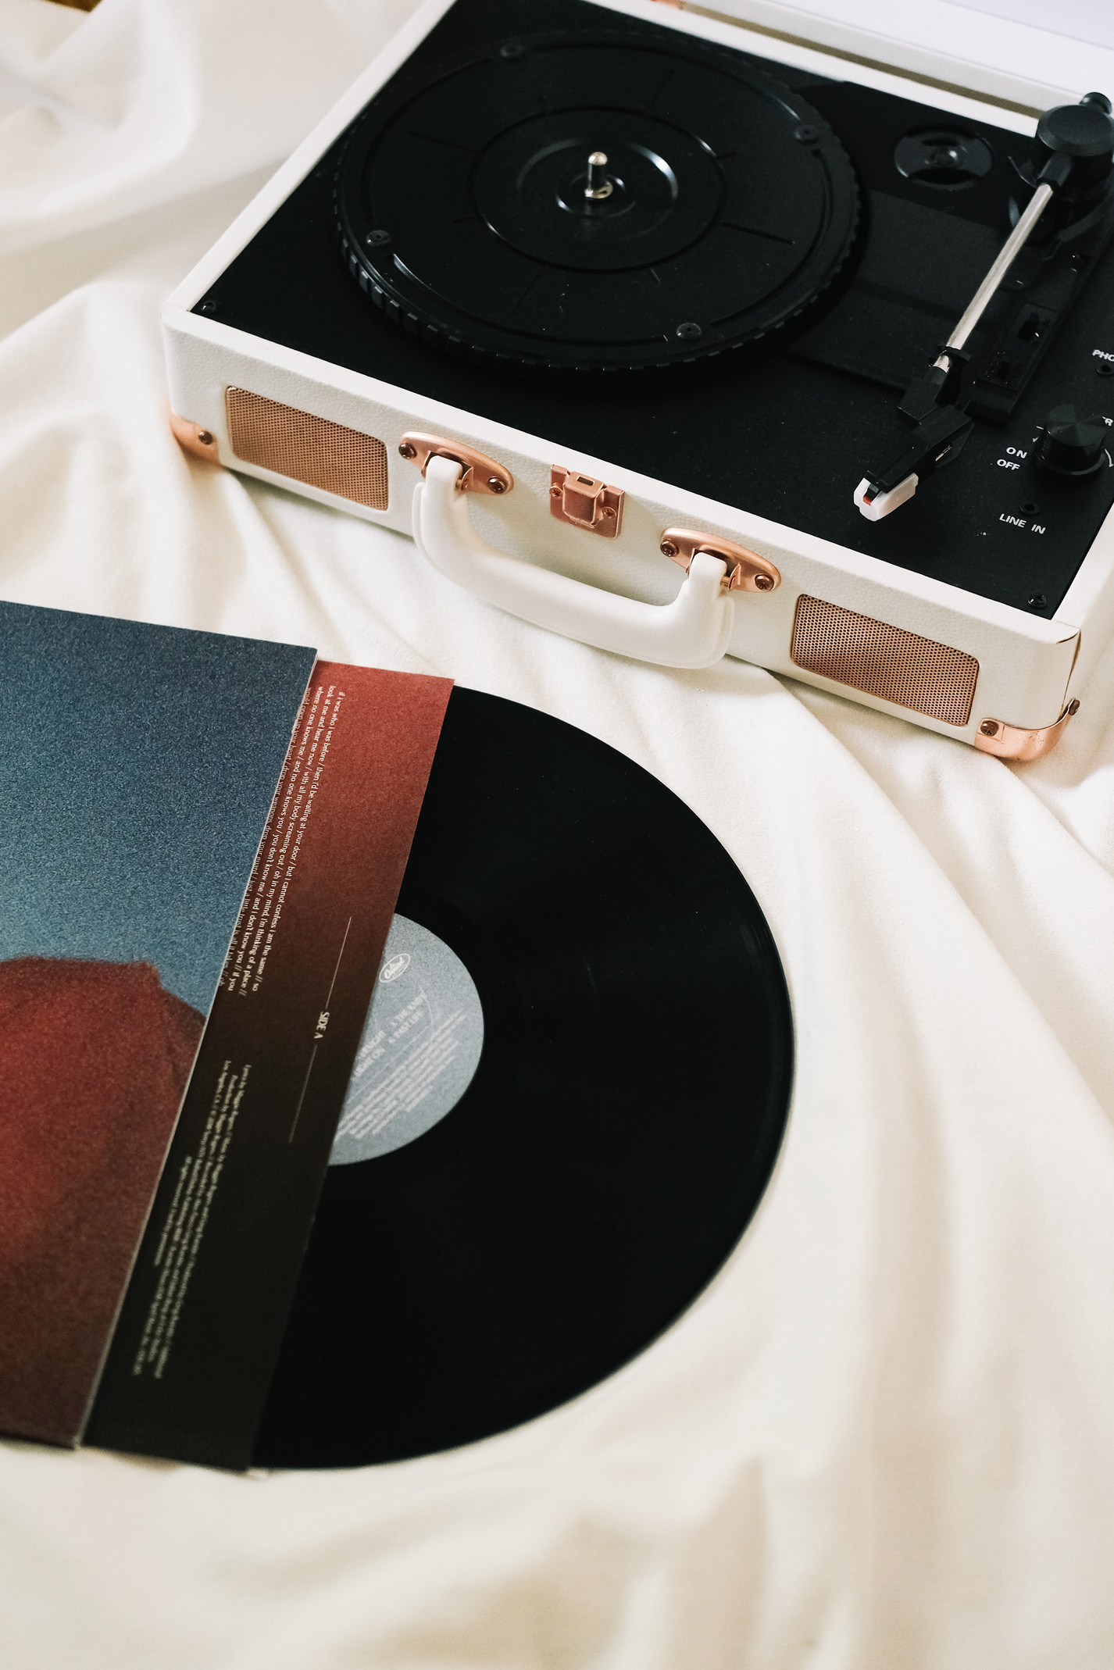

Digital Portfolio
01
STUDENT NAME: GURU M
REGISTER NO AND NMID:asunm1112401111033009
DEPARTMENT: BCA
COLLEGE: L. N. Government College, Madras university

Slide 2
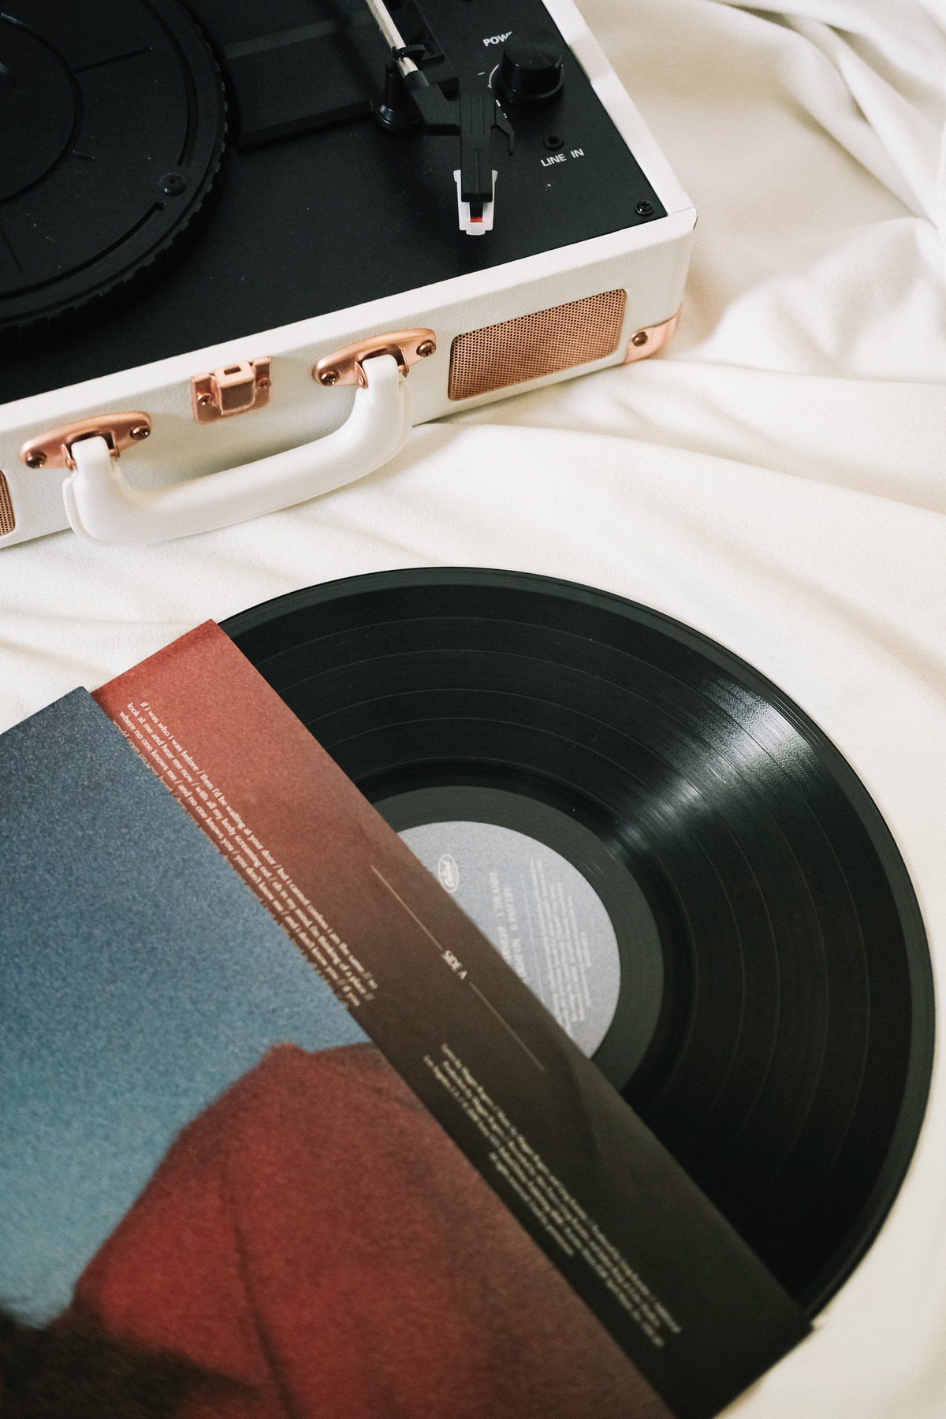

PROJECT TITLE
02
Digital Portfolio using fornt end web development

Slide 3

AGENDA
1.Problem Statement
2.Project Overview
3.End Users
4.Tools and Technologies
5.Portfolio design and Layout
6.Features and Functionality
7.Results and Screenshots
8.Conclusion
9.Github Link

Slide 4

PROBLEM STATEMENT
In today's world, traditional resumes and CVs are no longer enough. Recruiters and clients want to see real work and practical applications.Students often struggle to present academic projects in a professional format.Job seekers need a platform that goes beyond plain text documents. Many professionals lack a central place to highlight their skills and experience.A digital portfolio solves this gap by combining resumes, projects, and skills in one place.It also offers interactivity with visuals, animations, and structured content. Without a portfolio, opportunities may be lost due to weak first impressions. A modern portfolio can act as a digital identity card in academic and career growth.
This project addresses the need for a personal branding solution

Slide 5

PROJECT OVERVIEW
This project is about creating a student digital portfolio website.
2. The portfolio is a professional, structured, and interactive website
3. It begins with a Home section, giving an introduction and call-to-action
4. The About section highlights career goals, personal details, and passions
5. The Skills section lists technical abilities like HTML, CSS, JavaScript, and Python
6. The Projects section showcases practical works such as Al chatbots, web apps, and designs.
7. Each project is displayed in attractive cards with hover effects for visual appeal
8. The Contact section provides a form, email links, and social profiles. The website is fully responsive, working smoothly on mobile and desktop.It acts as a professiona digital identity, leaving a strong impression on recruiters and collaborators.

Slide 6

WHO ARE THE END USER?
The portfolio is designed for a wide range of users
Students can use it to showcase academic projects, resumes, and skills
Job seekers can share their portfolio links directly with recruiters
Instead of long attachments, recruiters can see work live on a website
Freelancers can show completed projects to attract clients.
It acts as a project gallery, demonstrating creativity and professionalism. Professionals can highlight experience, skills, and achievements
It helps in building a personal brand for long-term growth
End users gain a platform that makes them stand out in competition.
The portfolio is useful for career, academic, and freelancing opportunities
It ensures visibility and accessibility anytime, anywhere.

Slide 7


TOOLS AND TECHNIQUES
The portfolio is built using core web development tools.
HTML provides the structure of pages and sections.
CSS adds styling, colors, layouts, and responsiveness for all devices.
JavaScript ensures interactivity such as navigation, animations, and form validation.
The project uses modern coding practices for better performance.
Code editors like VS Code and CodePen were used for development.
The portfolio is hosted on GitHub Pages/Netlify, making it globally accessible
Responsive techniques ensure it works on mobiles, tablets, and
desktops.
Hover effects, smooth scrolling, and animations improve
user experience.
Together, these tools create a functional, attractive, and professional portfolio
POTFOLIO DESIGN AND LAYOUT

Slide 8

POTFOLIO DESIGN AND LAYOUT
The design follows a clean and modern layout.
The Home section welcomes visitors with a professional intro.
The About section shares career goals, skills, and aspirations.
The Skills section lists technical knowledge and tools used.
The Projects section shows sample works with images and details.
Each project card includes titles, descriptions, and live demo links.
The Contact section provides a form and clickable links for communication.
The design is fully responsive, ensuring accessibility on any screen.
Smooth navigation allows visitors to reach sections easily.
The layout creates a balanced mix of professionalism and creativity

Slide 9

FEATURES AND FUNCTION ALITY
The portfolio provides easy navigation with a clean interface.
2. Projects are displayed with visual appeal and animations.
3. It creates a memorable first impression for recruiters and clients.
4. Visitors can explore skills, projects, and achievements in one place.
5. The website works on all devices, from laptops to smartphones.
6. The contact form allows direct communication with potential employers.
7. It boosts professional credibility and builds trust with recruiters.
8. Users can share their portfolio link on LinkedIn, email, and resumes.
9. The portfolio gives users a competitive advantage in applications
Your paragraph text

Slide 10
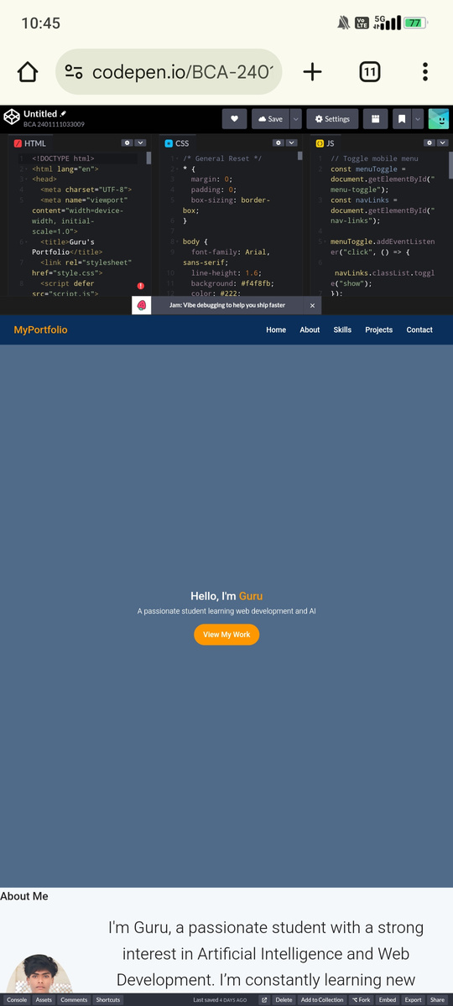
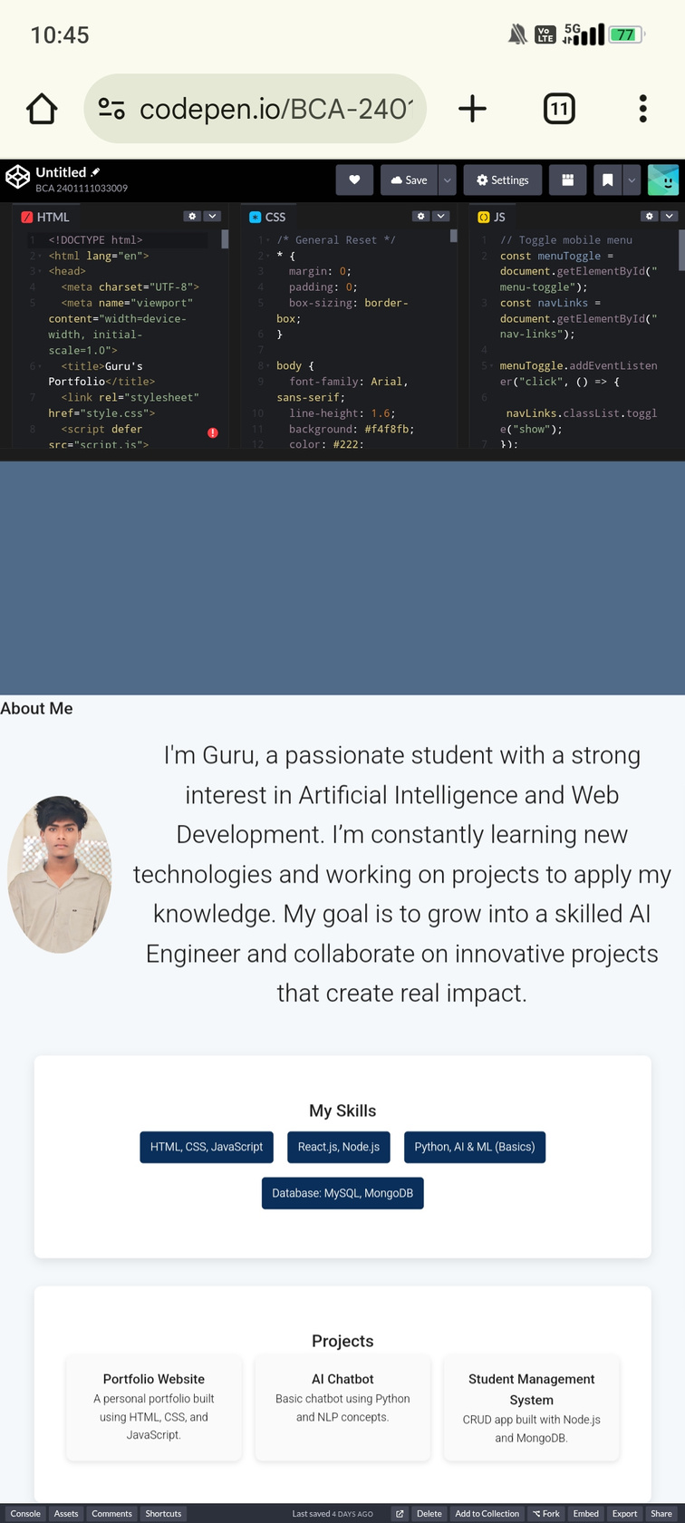
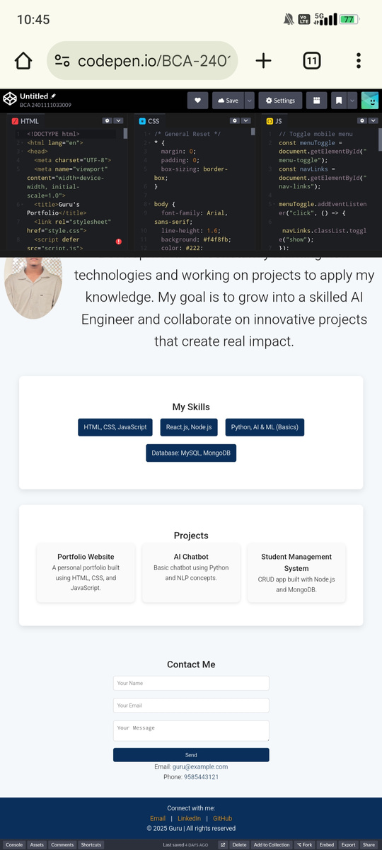
RESULTS AND SCREENSHOTS

Slide 11
CONCLUSION
A digital portfolio is a modern replacement for traditional resumes.
It provides an interactive and professional identity.
The project demonstrates knowledge of HTML, CSS, and JavaScript.
It shows the ability to design and develop responsive websites.
The portfolio highlights achievements, skills, and real-world projects
It is useful for students, job seekers, freelancers, and professionals.
Recruiters and clients gain confidence by seeing actual work samples.
The portfolio boosts career opportunities and academic visibility.
It leaves a lasting positive impression on potential employers.
In conclusion, a digital portfolio is a gateway to success in the digital age

